Slide 1

Find a Right Web -Student App
BATCH NO: 17
UNDER THE ESTEEMED GUIDANCE OF
Dr. P. CHIRANJEEVI, Ph.D. Professor & HOD, CSE
DEPARTMENT OF COMPUTER SCIENCE AND ENGINEERING AMRITA SAI INSTITUTE OF SCIENCE AND TECHNOLOGY
Paritala, Vijayawada, Andhra Pradesh(521180)

Slide 2
Find a Right Web Student App
Submitted by: S. NITHIN SAI (22AJ5A4406) S. MANOHAR NAIK (22AJ5A4404) B. VENKATA SAITEJA (21AJ1A4409)
Under the guidance of: Dr. P. CHIRANJEEVI, Ph.D. Professor & HOD, CSE
Department: Computer Science and Engineering (Data Science)
Institution: Amrita Sai Institute of Science and Technology (Autonomous) Affiliated to JNTU Kakinada | NAAC ‘A’ Grade Accredited
Date: April 2025

Slide 3
ABSTRACT
The rapid growth of online learning platforms has led to an overwhelming number of available courses, making it challenging for students to find the most suitable options. To address this issue, we developed "Find A Right Web: A Student App", a multi-company course aggregator that centralizes course discovery from various platforms. Built using HTML, CSS, and JavaScript, the application features a responsive and intuitive user interface that enhances user experience.
We collected and organized extensive course data from multiple sources to ensure comprehensive aggregation. Additionally, we employed AI-driven optimization techniques to deliver personalized course recommendations, helping users find relevant content efficiently. Beyond development, we actively participated in project planning, marketing strategies, and stakeholder engagement to maximize the project's impact and outreach.
This application not only streamlines the course selection process but also sets the foundation for future enhancements, including personalized career pathways and blockchain-based certificate verification. By leveraging modern web technologies and data-driven insights, Find A Right Web empowers students to make informed learning decisions.

Slide 4
ABOUT THE PROJECT
With the rise of online learning platforms such as Coursera, Udemy, and edX, students often struggle to identify the most suitable courses websites . Traditional search methods rely on keyword-based filtering, which lacks personalization. The Find A Right Web: A Student App seeks to bridge this gap by aggregating courses from multiple providers and applying AI-driven recommendations based on user preferences, learning history, and market trends. The system ensures a centralized, efficient, and user-friendly course discovery process.
For best things the application which is the useful for every student, there get all information in an single app which had best features and best User interface.
As a part of that we need forward this as much higher.
We focus on digital marketing, app development, new version releases etc.

Slide 5
CONTENTS
1. Project Overview
2. Key Features
3. UI/UX Design & Theme
4. Technical Architecture
5. Code Structure & Organization
6. Interactive Features & Enhancements
7. Future Enhancements & Roadmap
8. Demo & Screenshots
9. Technical Challenges & Solutions
10. Project Impact & User Benefits
11. Future Plans for "Find A Right Web: A Student App"

Slide 6
1. Project Overview

Slide 7
1. Project Overview
Objective
• To create a one stop solution for students to discover quality online courses, explore career opportunities, and manage learning resources.
Key Elements
• Multi page structure (Login, Home, Courses, Career, Profile, About)
• Netflix inspired dark theme with vibrant red accents
• Interactive features such as dynamic search, favorites, and progress tracking
Notes
• Emphasize how the app addresses the needs of modern students by integrating learning and career exploration into one platform.

Slide 8
2. Key Features

Slide 9
2. Key Features
Authentication
• Phone OTP and Google Sign in with accessible ARIA labels
Dynamic Home Page
• Animated welcome section with fade in effects
• Image carousel featuring inspirational images with captions
• Featured resources section with call-to-action buttons
Courses Module
• Grid layout with fuzzy search and category filtering
• Ability to mark courses as favorites (saved in localStorage)

Slide 10
2. Key Features
Career Module
• Grid layout similar to Courses for career opportunities
Profile Module
• Displays user details, a progress bar for course completion, and a list of favorite courses
About Section
• Comprehensive description of the app’s mission and benefits
Notes
• Briefly describe each module’s functionality and how they interconnect.

Slide 11
3. UI/UX Design & Theme

Slide 12
3. UI/UX Design & Theme
Accessibility
Design Inspiration
• High contrast for readability, ARIA labels for interactive elements, and keyboard navigable menus
• Netflix inspired dark theme with bold red accents
Visual Elements
• High contrast backgrounds, dynamic gradients, and animated transitions
• Consistent typography using "Poppins"
• Micro interactions such as hover effects, fade in animations, and subtle scaling of cards
Frameworks Considered
• Custom CSS with inspiration from Bootstrap, Tailwind CSS, etc.

Slide 13
4. Technical Architecture

Slide 14
4. Technical Architecture
Frontend Technologies
• HTML5, CSS3, JavaScript
Multi Page Structure
• Separate HTML files for Login, Home, Courses, Career, Profile, and About
Interactivity
• Fuzzy search using the Jaro-Winkler algorithm
• LocalStorage for storing user favorites
Responsive Design
• Fluid grid layouts and responsive navigation ensuring compatibility across devices
Notes
• Emphasize the simplicity and efficiency of your tech stack and how it meets performance needs.

Slide 15
5. Code Structure & Organization

Slide 16
5. Code Structure & Organization
Files Included
• login.html: Authentication screen
• index.html: Home page with dynamic content
• courses.html: Courses grid with search/filter
• career.html: Career opportunities grid
• profile.html: User profile and favorites
• about.html: App information
• style.css: Netflix inspired dark theme styles
• login.js: Login interactions
• index.js: Main interactivity (grid rendering, search, favorites, sidebar navigation)
Assets
• Discuss how the separation of concerns (HTML for structure, CSS for styling, JS for interactivity) benefits maintainability and scalability.
Notes
• Logos stored in a dedicated "logos" folder (or using online URLs)

Slide 17
6. Interactive Features & Enhancements

Slide 18
6. Interactive Features & Enhancements
Dynamic Home Page
Career Module
Future Features (Planned)
• Animated welcome text and image carousel for an engaging first impression
• Grid layout for career opportunities mirroring the Courses design
• Real-time notifications, user reviews, and advanced analytics
Courses Module
Profile Module
• Fuzzy search and filter dropdown to quickly locate desired courses
• "Favorite" feature enabling users to save courses
• Displays a progress bar and favorite courses for a personalized experience

Slide 19
7. Future Enhancements & Roadmap

Slide 20
7. Future Enhancements & Roadmap
User Profile Management
Advanced Search & Personalization
• Integrate machine learning for personalized recommendations
• Expand filtering options by course level, duration, and more
• Allow users to update personal details and upload profile pictures
Enhanced Interactivity
Scalability & Performance
• Real-time notifications and a feedback system
• Community features such as ratings and comments on courses
• Implement lazy-loading for images, optimize assets, and potentially use a backend server

Slide 21
8. Demo & Screenshots

Slide 22
8. Demo & Screenshots
Screenshots
Demo
• Login page
• Home page with carousel and welcome animation
• Courses page with search, filter, and favorite icons
• Career page displaying career cards
• Profile page showing user details and favorites
• About page with detailed app information
• Optionally, include a link or embedded video demonstrating key interactions and animations

Slide 23
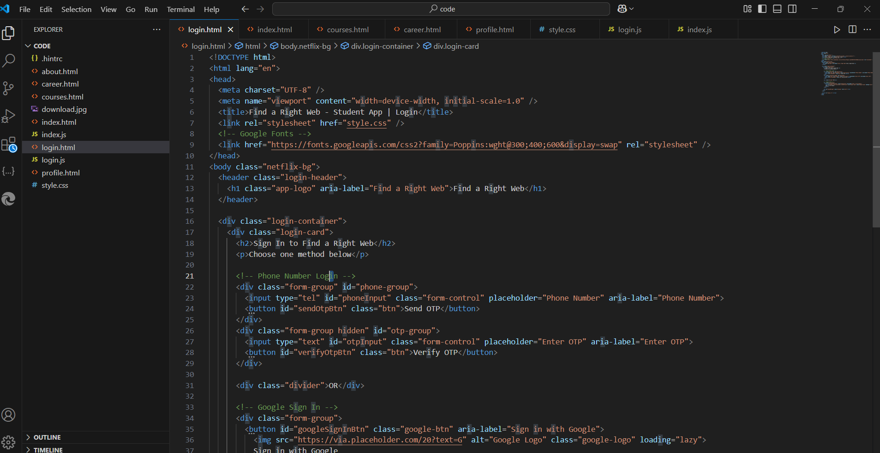
Demo & Screenshots

Slide 24
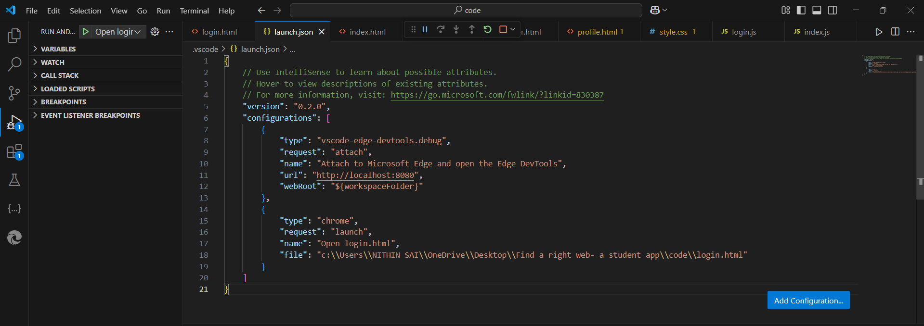
Demo & Screenshots

Slide 25
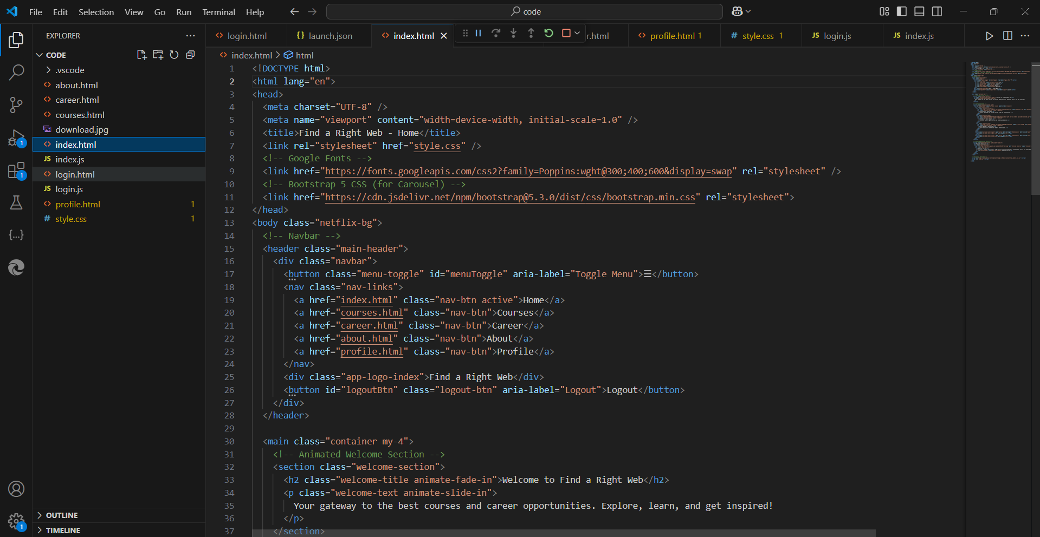

Slide 26
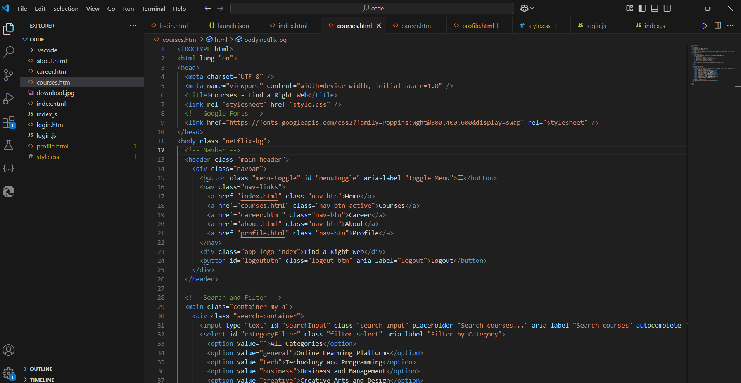

Slide 27
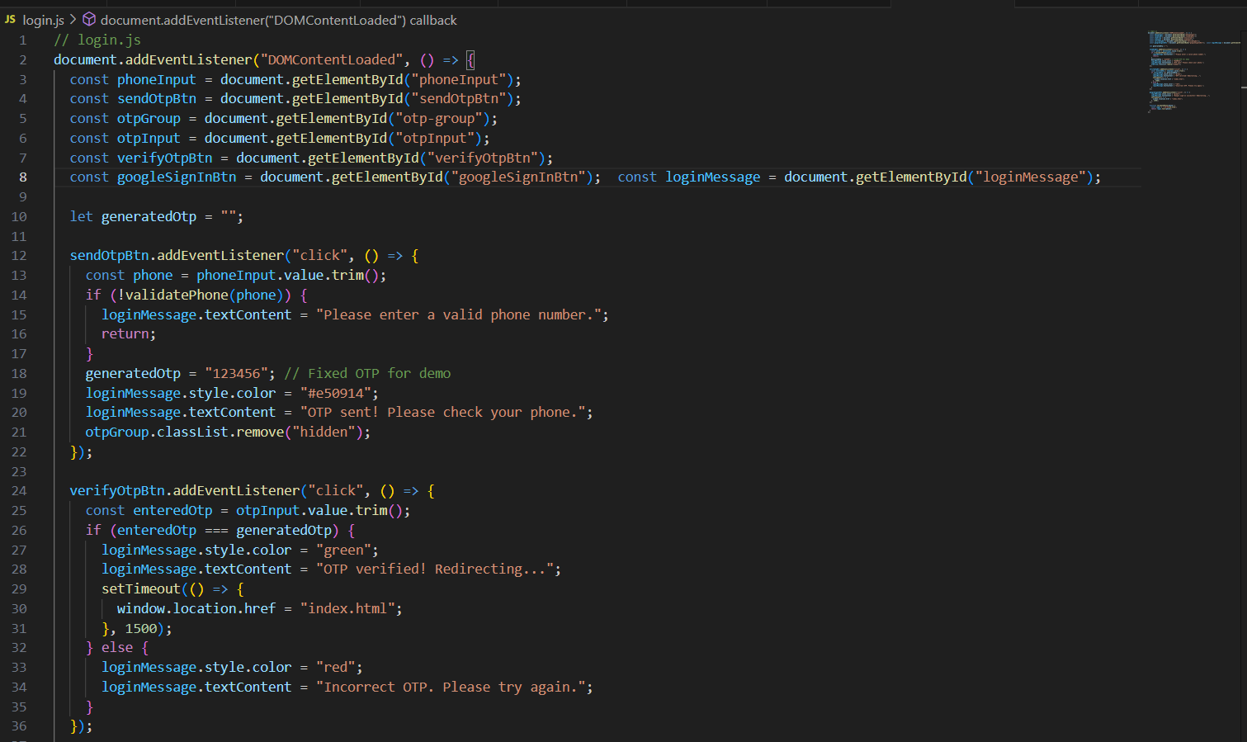
Demo & Screenshotst

Slide 28
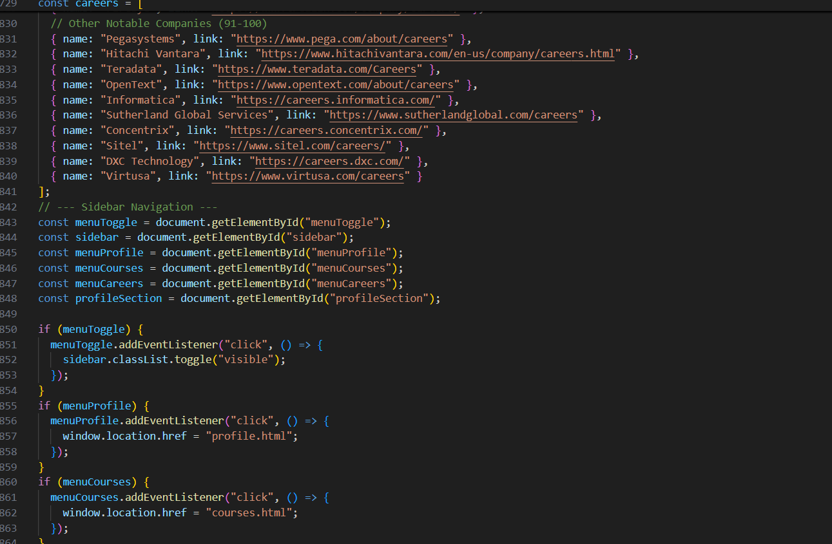
Demo & Screenshots

Slide 29
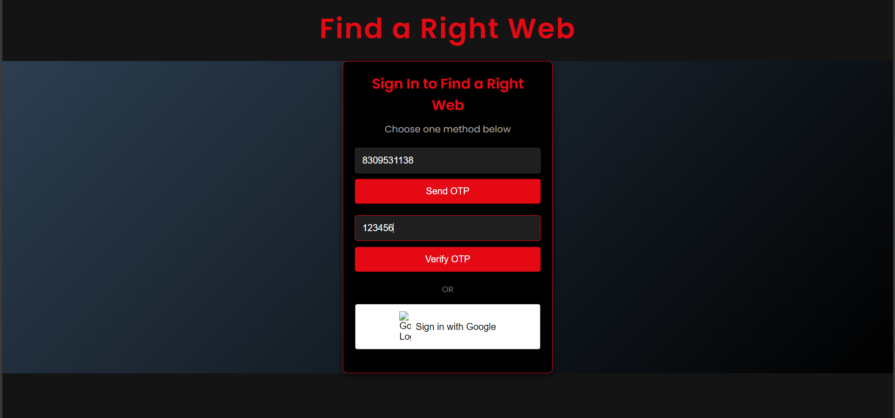
Demo & Screenshots

Slide 30
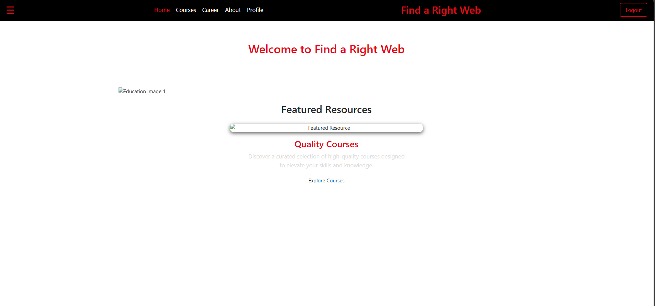
Demo & Screenshots

Slide 31
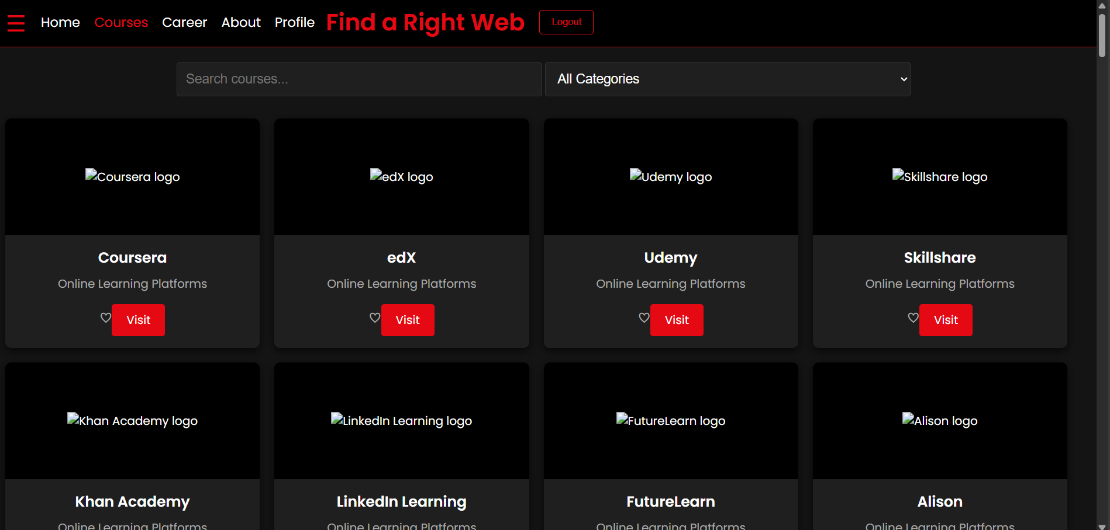

Slide 32
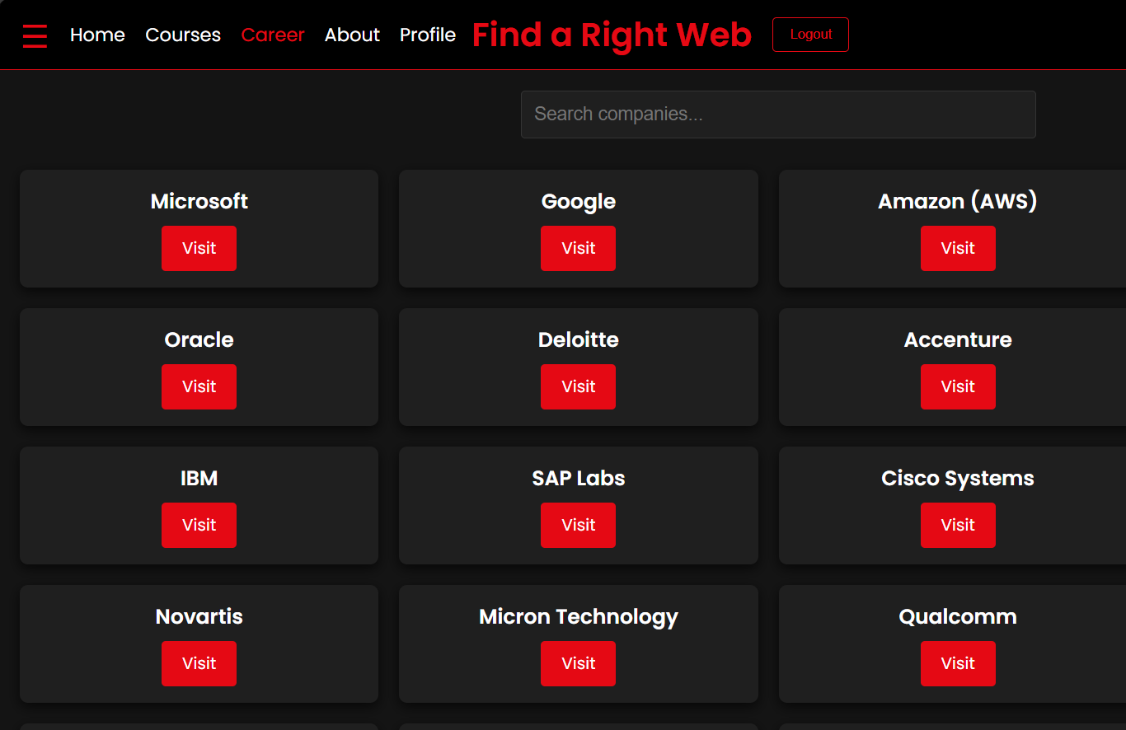
Demo & Screenshots

Slide 33
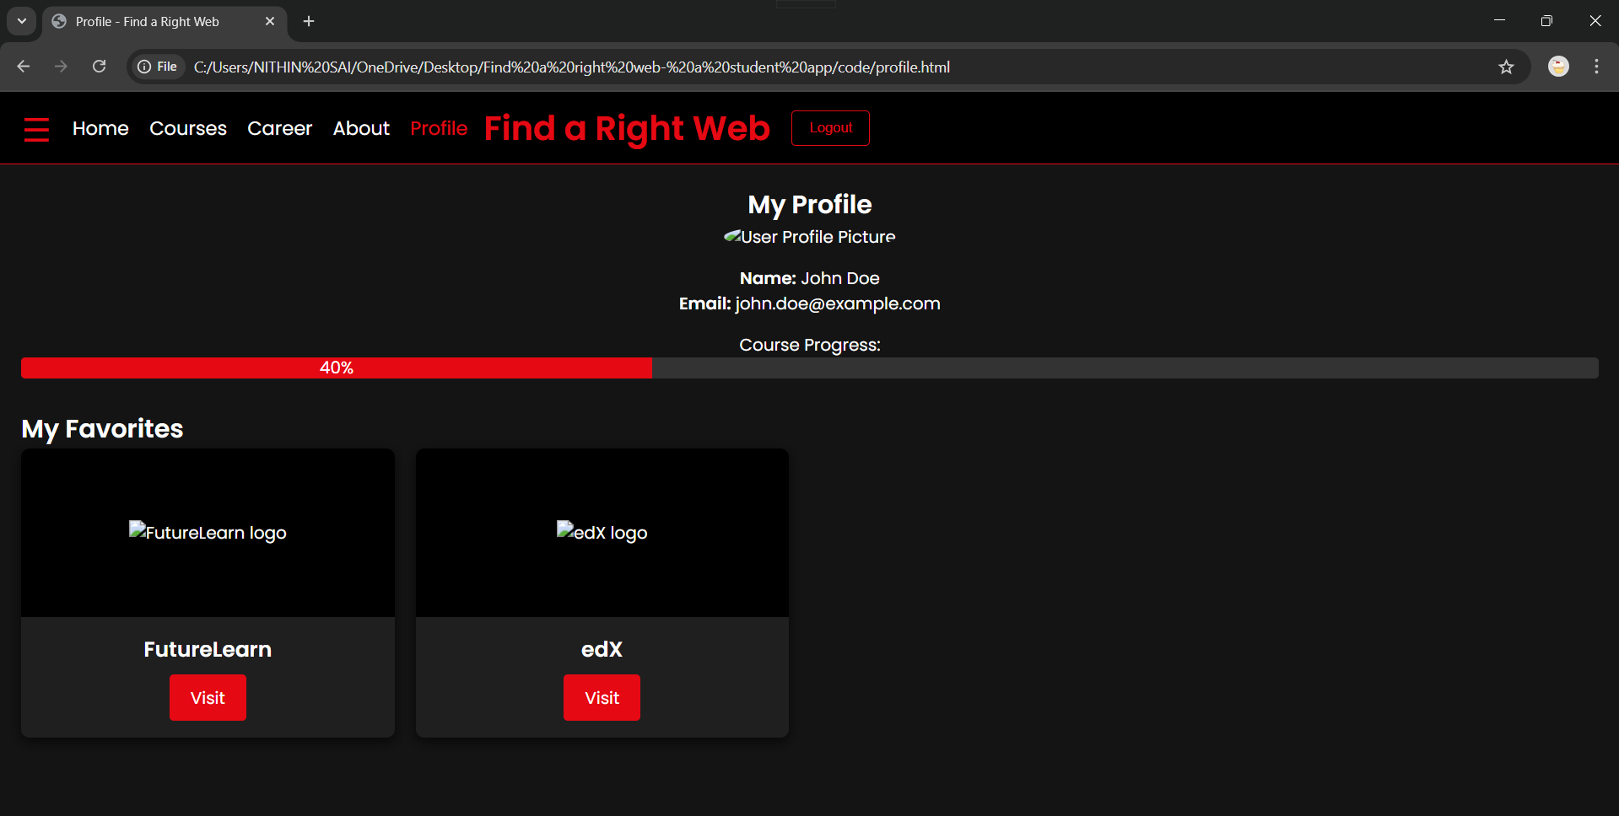

Slide 34
9. Technical Challenges & Solutions

Slide 35
9. Technical Challenges & Solutions
Challenges
Solutions
• Implementing fuzzy search efficiently (Jaro-Winkler algorithm)
• Ensuring a responsive, cross-browser compatible design
• Managing state for favorites with localStorage
• Optimized search function with debouncing to avoid UI freeze
• Clean, modular code structure separating concerns
• Extensive testing across different devices and browsers

Slide 36
10. Project Impact & User Benefits

Slide 37
10. Project Impact & User Benefits
For Students
• Centralized platform for learning and career exploration
• Easy navigation and interactive features to enhance engagement
• Personalized experience with favorites and progress tracking
For Educators/Employers
• Showcase high-quality courses and career opportunities
• Potential integration with analytics for targeted improvements

Slide 38
11. Future Plans for "Find A Right Web:
A Student App"

Slide 39
Future Plans for "Find A Right Web: A Student App"
AI-Powered Course Recommendations
Improve the recommendation engine using Machine Learning (ML) to suggest courses based on user preferences, past searches, and trending topics.
Internship & Job Portal Integration
Collaborate with job portals (LinkedIn, Naukri, Indeed) to display internship and job opportunities alongside courses.
Live Mentorship & Webinars
Introduce mentorship programs where students can interact with industry professionals through live webinars, Q&A sessions, and career guidance chats.
Resume & Portfolio Builder
A built-in resume generator that helps students create professional CVs based on their courses, skills, and projects.
Certification Verification System
Validate course completion certificates through a blockchain-based system, ensuring authenticity and credibility.

Slide 40
Multi-Language Support
Expand to support regional languages to help students from non-English backgrounds access courses easily.
Gamification & Leaderboards
Introduce badges, rewards, and leaderboards to encourage students to complete courses and improve engagement.
Mobile App Development
Develop a fully functional mobile app for Android & iOS to make learning accessible anytime, anywhere.
AI Chatbot for Career Guidance
Implement an AI chatbot that provides career suggestions, job opportunities, and study plans based on student interests.
Global Expansion & Collaborations
Partner with universities & online learning platforms worldwide to offer a wider range of high-quality courses.

Slide 41
Thank You

